Slide 1

Intervals for Prediction
Reading: 2.4
exercises: cH 2. 11abcd
Assigned: hw 6
Producer: dr. mario
img credit: alex riegert-waters

Slide 2
Example: Fatalities
Question: Is there a linear relationship between the percent of young drivers in a state and the number of vehicle fatalities per 1,000 people in a state?
Question: What would we predict the number of vehicle fatalities of a state to be where 20% of the state’s drives are young drivers?
Recall: A Young Driver is Between 15 and 24 (inclusive)

Slide 3

Supplement for Lecture 12
Estimate Linear Regression Model
Predict for $x^{∗}=0.2$
Interpretation:

Slide 4

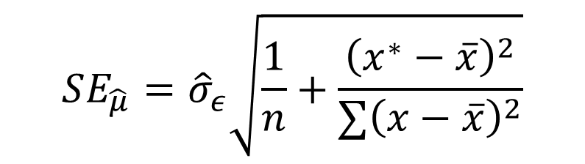
Confidence Interval for Mean Response
Formula:
Standard Error
$$\hat{y}±t_{0.025,n−2}SE_{\hat{μ}}$$
$$SE_{\hat{μ}}={\hat{σ}}_{ε}\sqrt{\frac{1}{n}+\frac{{\left(x^{∗}−\overline{x}\right)}^{2}}{∑{\left(x−\overline{x}\right)}^{2}}}$$

Slide 5

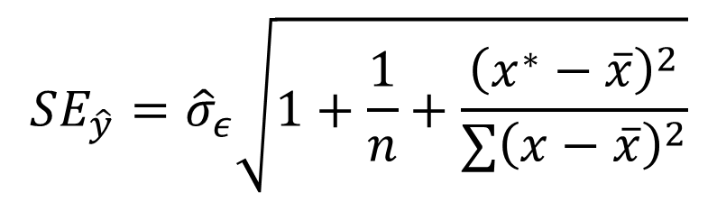
Prediction Interval for Single Observation
Formula:
Standard Error
$$\hat{y}±t_{0.025,n−2}SE_{\hat{y}}$$
$$SE_{\hat{y}}={\hat{σ}}_{ε}\sqrt{1+\frac{1}{n}+\frac{{\left(x^{∗}−\overline{x}\right)}^{2}}{∑{\left(x−\overline{x}\right)}^{2}}}$$

Slide 6
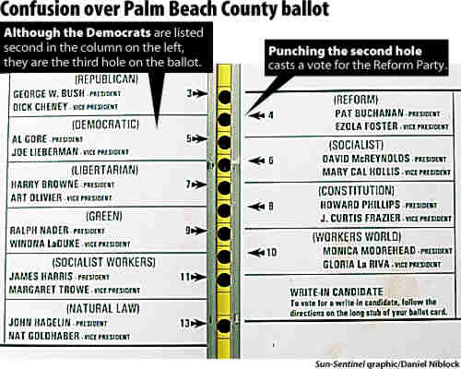
Example: Butterfly Ballots
2000 Election
Bush (Republican)
Gore (Democrat)
Buchanan (Third Party)
Unusual Results in Palm Beach
Nonstandard “Butterfly Ballot”
Accidental Voting?

Slide 7
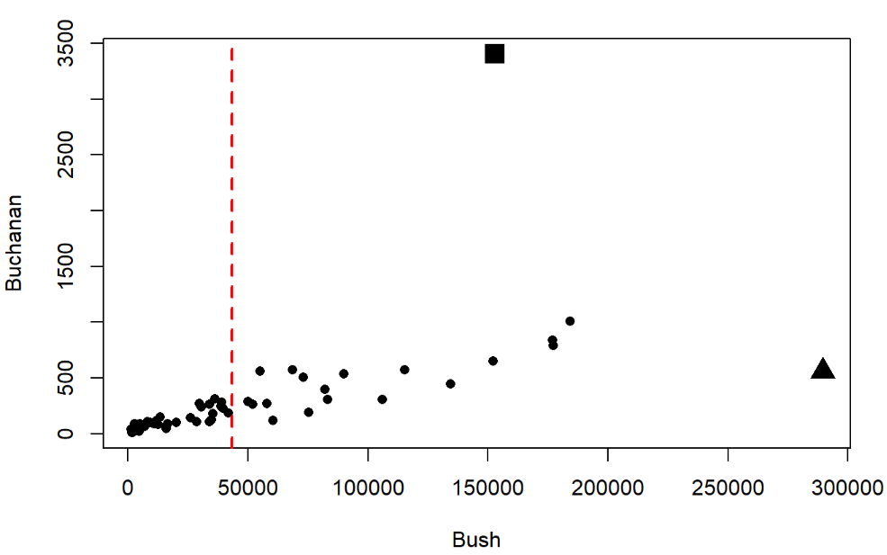
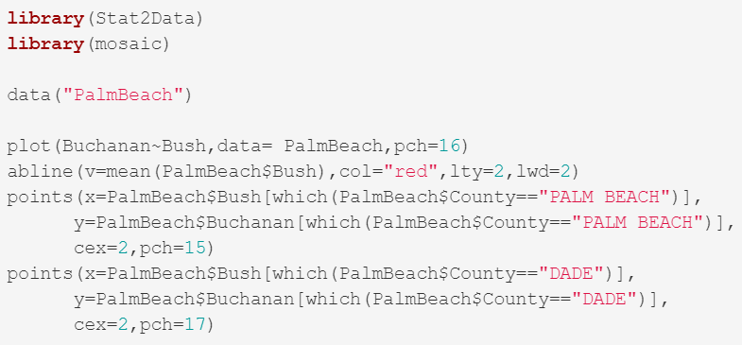
Example: Butterfly Ballots
Palm Beach
Dade

Slide 8
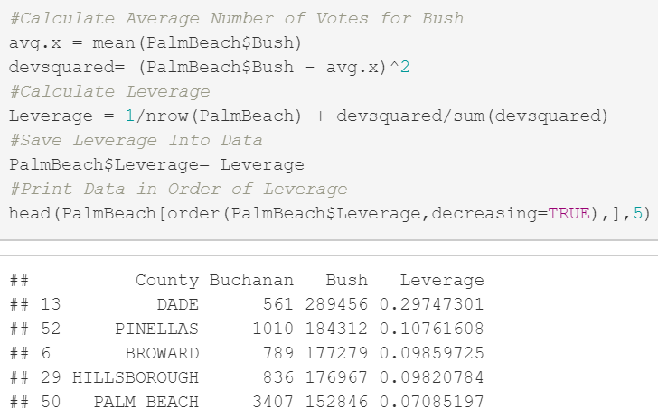

Example: Butterfly Ballots
Very Unusual Leverage
“Triple the Typical Leverage”
$$3∗\frac{2}{n}=3∗\frac{2}{67}=0.09$$

Slide 9

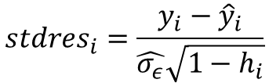
Standardized Residual
Old Formula:
New Formula:
Further Adjust for Leverage Since Some Points Impact More
Points with More Leverage Tend to Higher Standardized Residuals
$$stdres_{i}=\frac{y_{i}−{\hat{y}}_{i}}{\hat{σ_{ε}}}$$
$$stdres_{i}=\frac{y_{i}−{\hat{y}}_{i}}{\hat{σ_{ε}}\sqrt{1−h_{i}}}$$

Slide 10
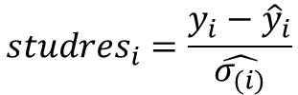
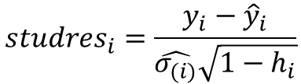
Studentized Residual
Old Formula:
New Formula:
We Calculate Standard Error of Regression After Removing Point
Line Doesn’t Change, Then Standardized Equals Studentized
$$studres_{i}=\frac{y_{i}−{\hat{y}}_{i}}{\hat{σ_{(i)}}}$$
$$studres_{i}=\frac{y_{i}−{\hat{y}}_{i}}{\hat{σ_{(i)}}\sqrt{1−h_{i}}}$$

Slide 11
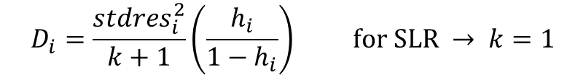
Cook’s Distance
Formula:
Amount of Influence Depends On:
Leverage
Distance from Line of “Best” Fit
Large Cook’s D Indicates Point Strongly Influences Regression
$$D_{i}=\frac{stdres_{i}^{2}}{k+1}\left(\frac{h_{i}}{1−h_{i}}\right) for SLR → k=1$$

Slide 12
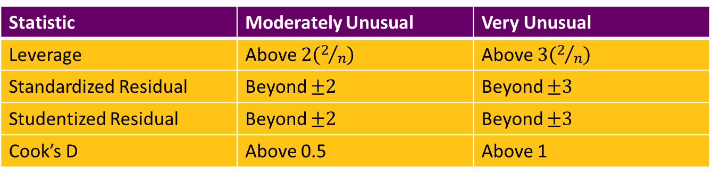
Rules of Thumb
We Can Calculate All Four Measures On Each Observation
Table Showing Accepted Definitions of
“Moderately Unusual”
“Very Unusual”
Statistic | Moderately Unusual | Very Unusual
Leverage | Above $2\left(2/n\right)$ | Above $3\left(2/n\right)$
Standardized Residual | Beyond $±2$ | Beyond $±3$
Studentized Residual | Beyond $±2$ | Beyond $±3$
Cook’s D | Above 0.5 | Above 1

Slide 13
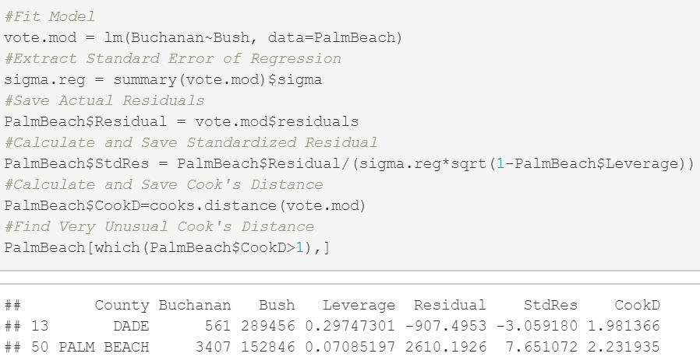
Example: Butterfly Ballots

Slide 14
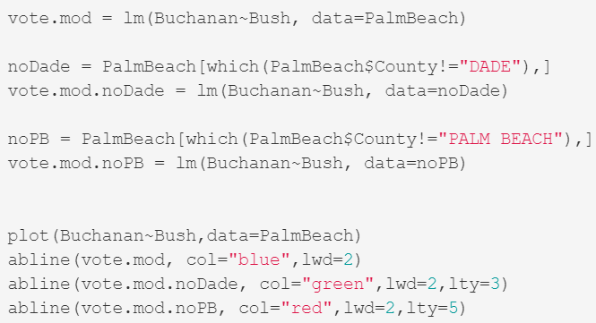
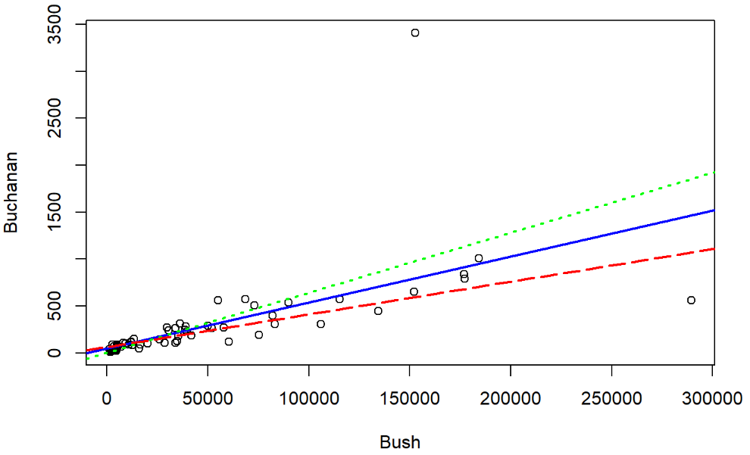
Example: Butterfly Ballots

Slide 15
Thank You
Make Reasonable Decisions

